Slide 1
Lost Connections
Mental depression is a silent villain !!

Slide 2
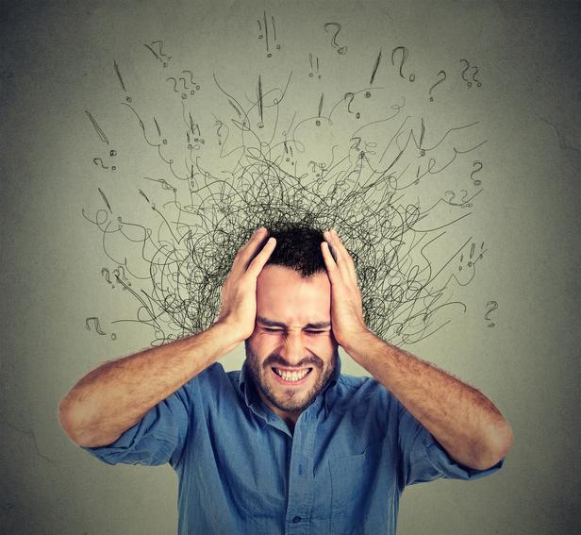
What is Mental Depression ?:
Depression (major depressive disorder) is a common and serious medical illness that negatively affects how you feel, the way you think and how you act.
Around 300 million people are affected by depression as per WHO
Most common factors include biochemical, environmental, genetics etc.,.

Slide 3


Johann Hari & his book “Lost Connections”

Slide 4
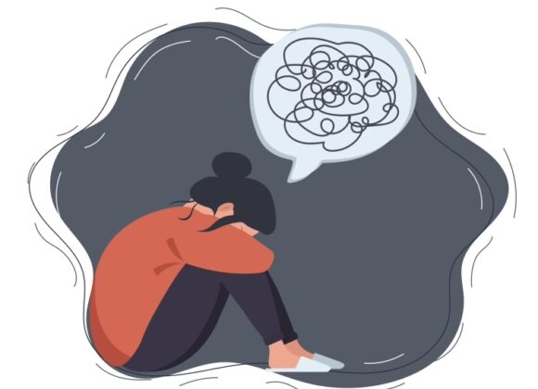
Important takeaways from the book
Depression is not the result of chemical imbalances in the brain
There are nine main causes, and they all have to do with difficult life circumstances
Social prescriptions make people valued and connected while medications does not

Slide 5
Johann’s 9 causes for depression:
Disconnection from meaningful work
Disconnection from others
Disconnections from meaningful values
Childhood trauma
Disconnect from status
Disconnect from nature
Disconnect from secure and hopeful future
Genetics
Changes in brain

